Slide 1
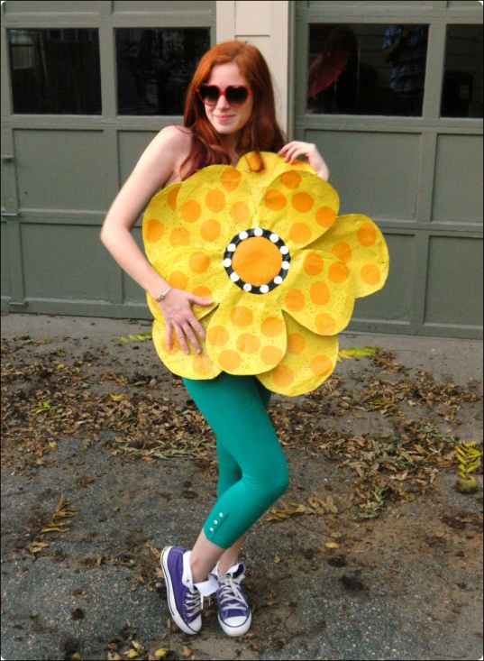
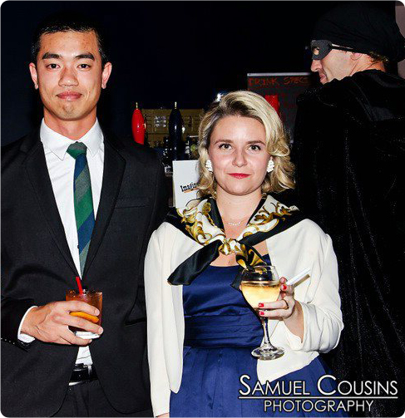
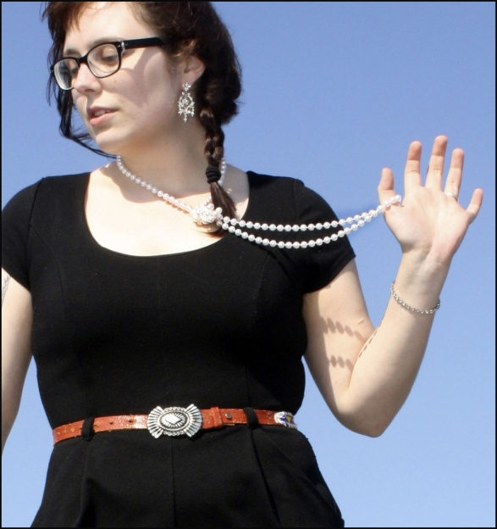
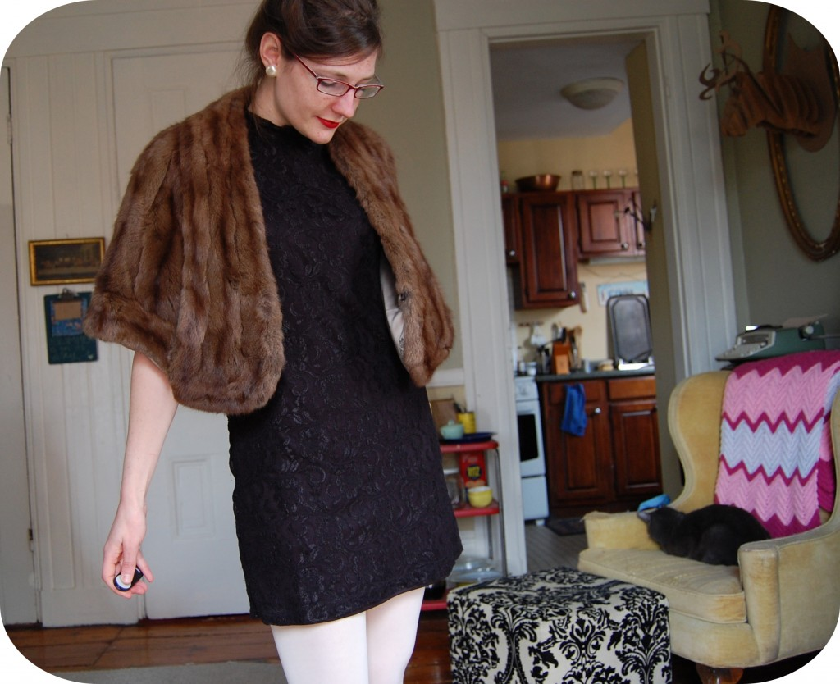

What I Wore:
Blogging Campaigns for Retail & Fundraising Success

Slide 2
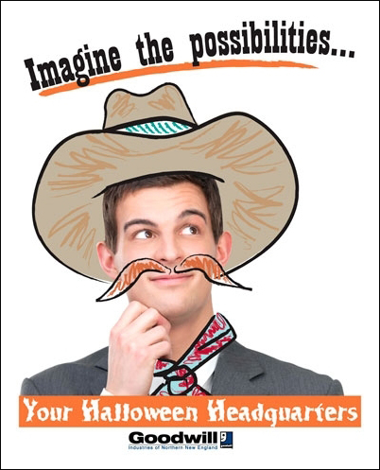

Three Primary Goals
Promote our retail initiatives/ fundraising events
Raise awareness about retail’s connection to Goodwill’s mission
Increase store sales, tickets purchased for events

Slide 3
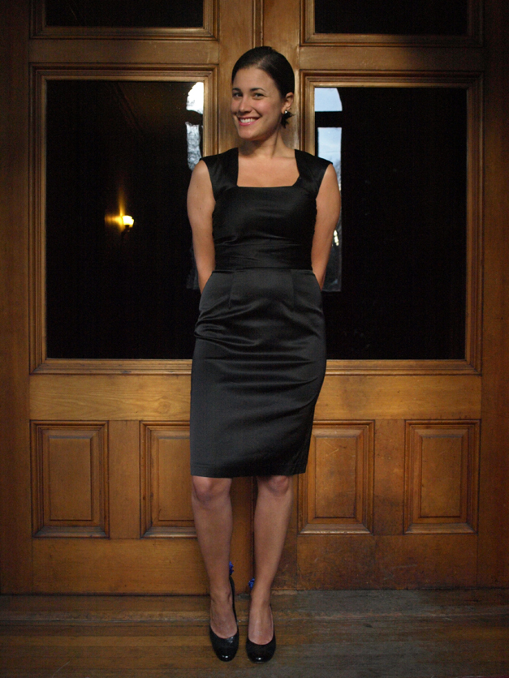
What was critical?
Have Goodwill shoppers share their own stories
Plan ahead!
Connecting posts to mission
Share posts via social media network to leverage engagement
Thank each blogger (gift cards, tickets)

Slide 4
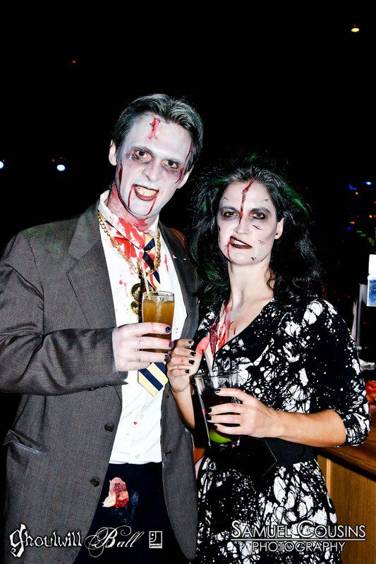
Outcomes
Blog series received over 7,000 views
Store sales for the month of October 2011 were up 1.5% over previous year
Little Black Dress raised $32,780
We received 12 inquiries from other bloggers, helping to further our blog engagement strategy.

Slide 5
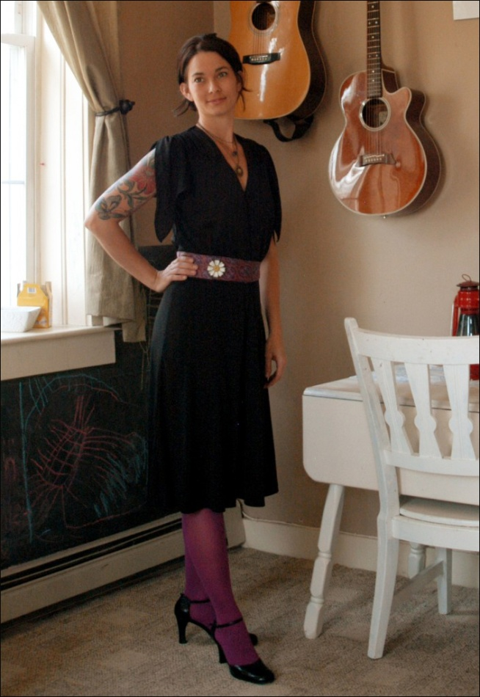
Facebook Stats
Halloween Series (average per post)
  Average reach: 1,381
  User engagement: 11.7
  Shares: 2.6
Little Black Dress Series (average per post)
  Average reach: 1,886
  User engagement: 18.4
  Shares: 3.8
  *Increase in 2,000 fans between October 2011 and April 2012

Slide 6
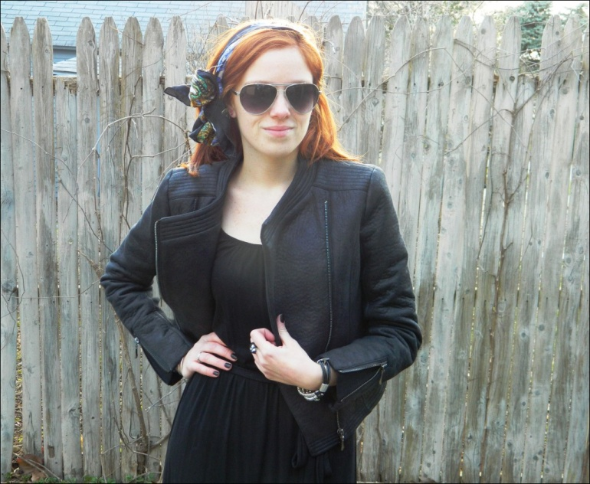
Partnership = Engaged Bloggers
Blog campaign depended on contributions from 17 bloggers throughout Maine, New Hampshire and Vermont.
Previous relationship
Readership and web influence

Slide 7
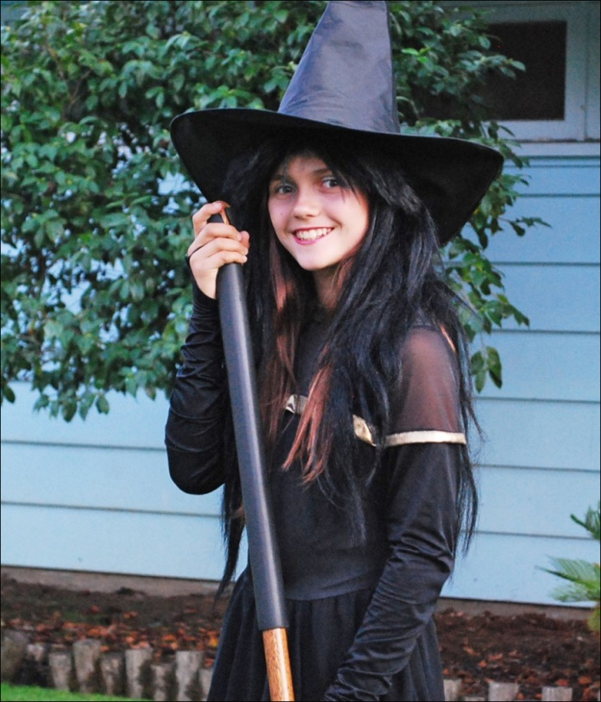
Conclusion
Blogging = an effective tool to support events, creates momentum
Complement to traditional marketing and media relations tools. Great for media pitches!
Both events inspired by other Goodwill events, demonstrating how we can support each other and further the overall sustainability of the brand.

Slide 8




Contact
Michelle Smith, Communications Manager
michelle.smith@goodwillnne.org
Goodwill Industries of Northern New England
www.goodwillnne.org/blog
goodwillnne

